Slide 1
CiteData: A New Multi-Faceted Dataset for Evaluating Personalized Search Performance
CIKM’10
Advisor : Jia-Ling , Koh
Speaker : Po-Hsien , Shih

Slide 2
Outline
Introduction
CiteData
Intrinsic Analysis of CiteData
Empirical Analysis of Personalized Search Algorithms
Result
CiteData Usage
Conclusion & Future Work

Slide 3
Introduction
Personalized search has become an increasingly important topic in IR (information retrieval) research in the recent years.
Comparative evaluation across current methods has been difficult, due to the lack of a common benchmark dataset that offers a rich set of diverse features so that different personalization strategies can be tested and compared in a controlled manner.

Slide 4
Introduction(cont.)
Having a multi-faceted benchmark dataset is crucial for facilitating personalized retrieval research and evaluations. We create a new dataset called CiteData .
This paper present a comparative evaluation of popular personalization strategies that utilize the different facets of CiteData .

Slide 5
CITEDATA
-Obtaining Document text,meta-data,hyperlink from CiteSeer
-Obtaining Social Tagging information from CiteULike
-Automatic Document Categorization
-User-tasks, and Personalized Queries and Relevance Judgements

Slide 6
CITEDATA(cont.)
CiteULike
Easy to get social tags,textual content ,document hyperlinks
Because it’s publicly editable, so it suffers from spam contamination.
Lack of categorization and personalized queries and relevance judgements.
CiteSeer
Its’ a popular repository of academic articles.
Use as the canonical source of information about academic articles.
Use CiteULike (social tagging website)as the foundation for the creation of the new benchmark collection.

Slide 7
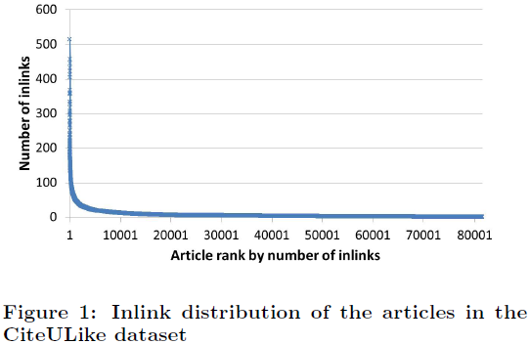
CITEDATA(cont.)
Obtaining Document text,meta-data,hyperlink from CiteSeer
the citation for each of the academic articles in the dataset to create a graph of academic articles for facilitating research in link-analysis based algorithms such PageRank Algorithm.

Slide 8
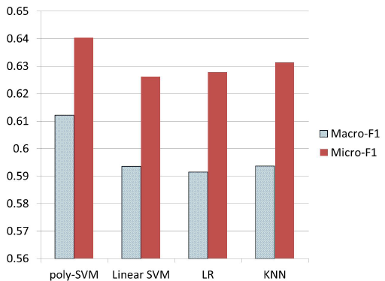
CITEDATA(cont.)
Obtaining Social Tagging information from CiteULike
Social tagging information is in a 4-tuple format < a, u, s, t >, where t is the tag assigned by user u to an article a at time s.
Must filter original dataset(ex. Genuine user ‘s requirement)
Automatic Document Categorization
Solicit volunteers to label , ODP , Yahoo topic hierarchy.
Multi-labeled classfication was achieved by using S-Cut thresholding strategy, that discovers optimal thresholds for classifying

Slide 9
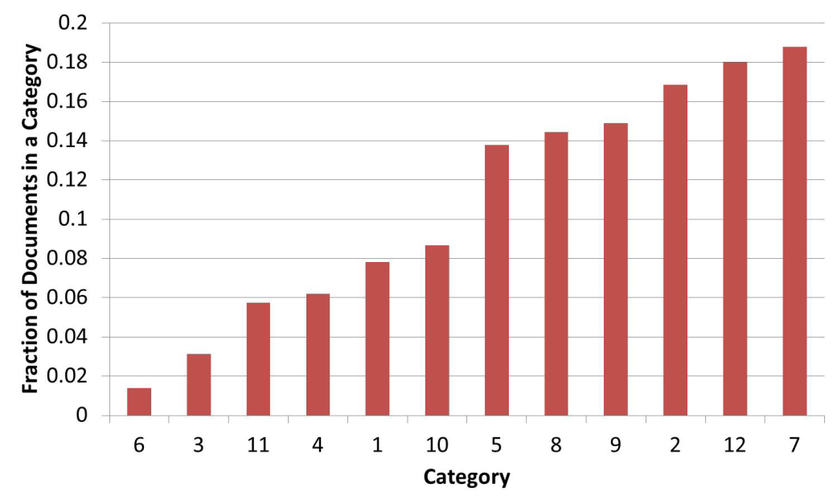
CITEDATA(cont.)
The distribution of articles per topic in the dataset after the SVM-based categorization step

Slide 10
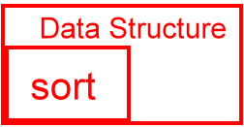
CITEDATA(cont.)
User-tasks, and Personalized Queries and Relevance Judgements
Solicited experts who can provide such annotations.
make sure that the proposed search tasks have enough relevant documents in the collection
CiteULike allows users to form groups to share articles in common areas of interests.

Slide 11
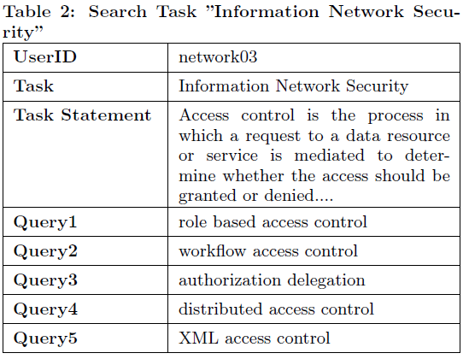
CITEDATA(cont.)
Once the groups and the experts were selected, we asked the experts to describe his/her search task in the form of a Task statement according to his/her own expertise.
The experts searched for articles using four to six queries to provide relevance judgments.

Slide 12
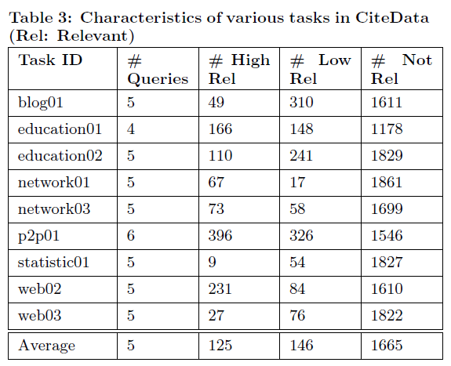
Intrinsic Analysis of Data
Basic statistics of the Annotation

Slide 13
Intrinsic Analysis of Data(cont.)
Test the reliability of the CiteData collection as an evaluation dataset by Classical test theory .

Slide 14
Intrinsic Analysis of Data(cont.)
The reliability coefficient can be estimated by analyzing the variance of individual test items and total test scores.
k is the number of items on the exam
is the estimated variance for item i
is the estimated variance of the total MAP scores.
Scores above 0.7 indicate reliable test collections that are effective at comparing performance of various algorithms.
(The Cronbach's alpha for CiteData collection is 0.9717).

Slide 15
Empirical Analysis of Pearsonalized Search Algorithms
-Matching user’s topical interest to document categories
-PageRank based link-analysis
-Using Collaborative Filtering over social tags
-Meta Personalized Search

Slide 16
Empirical Analysis of Pearsonalized Search Algorithms(cont.)
Matching user’s topical interest to document categories
The user's topical interests can be discovered based on the user's search history and bookmarks.
denotes the level of interest the user u has in topic c € 1….C.

Slide 17
Empirical Analysis of Pearsonalized Search Algorithms(cont.)
The user's interest at the document level can be computed as a linear combination of the user's topical distribution based on the categorization of that particular document.
denotes a measure of the interest of user u in the document d_{i}
is an indicator whether document d_{i} belongs to the cateogry c.
But user-specfic d(u) scores are not query sensitive.

Slide 18
Empirical Analysis of Pearsonalized Search Algorithms(cont.)
Query-sensitive personalized scores for a document d_{i} can be obtained by combining the user-specic scores d^{(u)} with query-specic retrieval scores q_{i}.
Simple implement: ex. Indri
TDS : Topical Distribution based Search

Slide 19
Empirical Analysis of Pearsonalized Search Algorithms(cont.)
PageRank based link-analysis
The PageRank scores are usually estimated by simulating a random walk over the linked graph of documents.
The vector denotes the PageRank scores of each of the articles in the network.
The matrix M encodes the transition probability from each page to each of its hyperlinks.
the vector denotes the random teleportation vector
If is uniform ?
=> Global PageRank (GPR) – Not particular user or topic

Slide 20
Empirical Analysis of Pearsonalized Search Algorithms(cont.)
Personalized PageRank(PPR)
A personalized teleportation vector which reflects the users interests in those pages.
Improving the scalability of the personalized approach to millions of users.
A popular approach by Jeh etc. computes the topic sensitive pagerank vectors for a canonical set of topics c € 1…C

Slide 21
Empirical Analysis of Pearsonalized Search Algorithms(cont.)
Using Collaborative Filtering over social tags
Discovering users with similar interests and then personalizing search based on the shared interests of users.
A user's act of tagging an article depicts an implicit interest of the user in the particular article.

Slide 22
Empirical Analysis of Pearsonalized Search Algorithms(cont.)
We use Probabilistic Latent Semantic Analysis (pLSA).
each user u € U has a probabilistic membership in each of the aspects, z € Z.
m is a binary random variable indicting interest in document d
The CF scores obtained for each of the documents estimate the user's interest in a particular document.
Meta Personalized Search

Slide 23
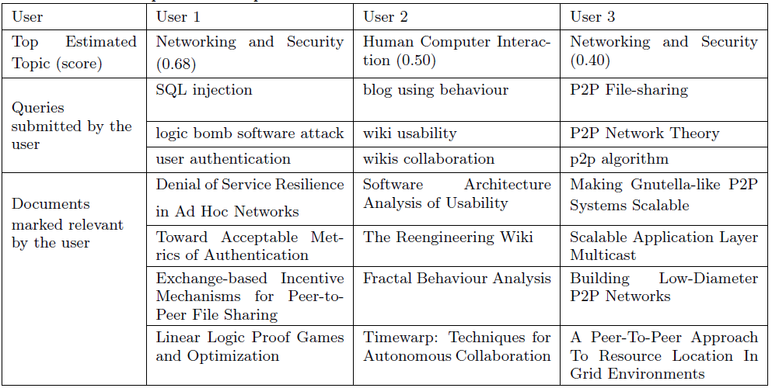
Result

Slide 24
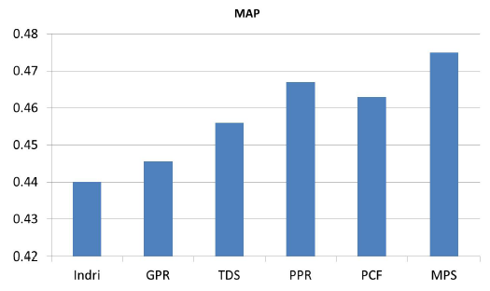
Result

Slide 25
CiteData Usage
CiteData is a rich dataset with several diverse features and is therefore amenable to evaluations beyond just personalized search.
CiteData can be used to evaluate classfication performance of algorithms that can benefit from treating such heterogenous features preferentially or by leveraging relationships between those features.
CiteData can also be used for evaluation of content based Collaborative Filtering algorithms

Slide 26
Conclusion & Future Work
A new multi-faceted dataset for the primary task of evaluating personalized search.
We use an empirical comparison of a rich set of representative personalized search approaches that utilize topic discovery, link-analysis and collaborative filtering.
In the future, we would like to explore approaches for leveraging such heterogeneous features for the aforementioned array of tasks.

